Slide 1
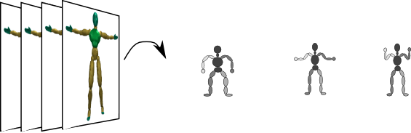
This is what we want to do (Tracking = seq. estimation of model from observations)
Video sequence
Sequence of estimated poses
Notes:
Recap:
First infer observations from image sequence
We have chosen the model.
Next we need to do inference for obtain estimates of model parameters.
<number>

Slide 2
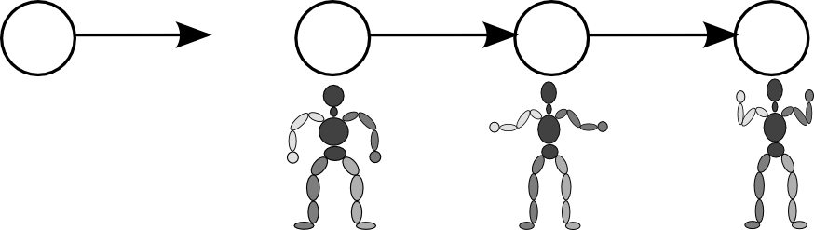
How do we include dynamics into our model?
Lets assume that the current state only depends on the immediate past state. We assume that somehow we can compute the new state given the old state!
Notes:
At every time instance our model is in some state / configuration
Or rather we want to include uncertainty so we model the probability of being in a certain configuration
Uncertainty e.g. due to ambiguities.
<number>

Slide 3
Enter probabilistic graphical models
This is an example of a simple graphical model:
First order Markov chain
A directed acyclic graph (DAG) or tree, if you will.
Def. Graphical model: Graph based model where nodes represent random quantities / variables and edges

Slide 4
Enter probabilistic graphical models
If we know the transition conditional probability distributions and the prior distribution on the initial state, we can compute the probability distribution of state sequences (of particular sequences of stick figures):
Short-hand notation:
Notes:
We need to model and learn / estimate these distributions
<number>

Slide 5
How to relate the model state with observations? (Tracking = estimation of model from observations)
Video sequence
Sequence of estimated states
Lets introduce a potentially non-linear function for “drawing the stick figure” in image space and compare with the observed image. Something like this,
However our observations are noisy so we want a probabilistic model for this!
Hard problem!
What do the image of a particular stick figure look like?

Slide 6
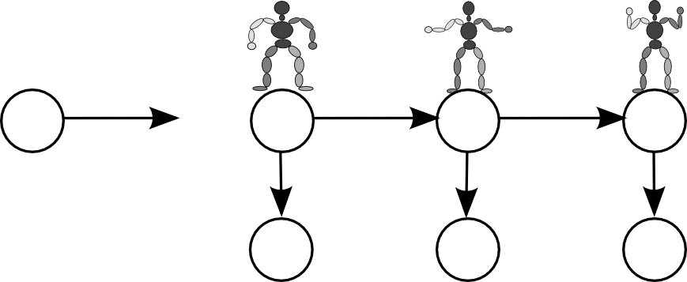
Enter hidden Markov models (HMM)
This model states that we only observe the images directly and the states indirectly – they are hidden (latent variables). If states are discrete we have a HMM.
Notes:
Lets extend the model with observations
<number>

Slide 7
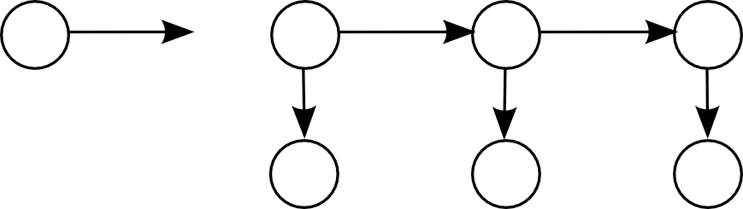
We need a probabilistic observation model
How about a Gaussian observation model?

Slide 8
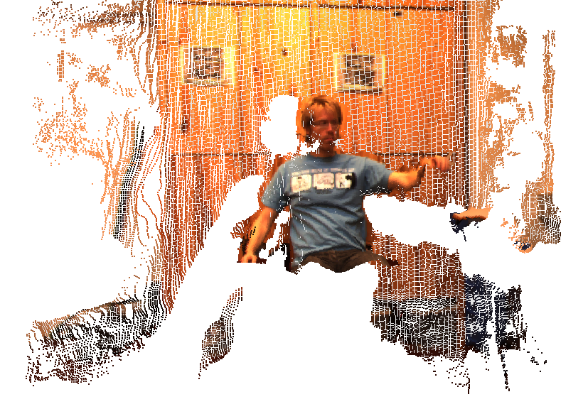
Observational model using depth maps
Observations are collections of 3D stereo points:
Introduce simple skin model: A capsule per bone.
Observational model:
Notes:
Concrete example of H:
Capsule = cylinder capped by hemispheres
Assume independence of stereo points and measure distance to capsule surface.
Shortest distance to skin and robust to outliers.
<number>

Slide 9
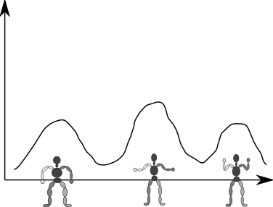
How to do tracking (estimation of pose)?
If we want to do real-time tracking we need
And then take averages to compute a prediction of the current state.
The model gives us the joint distribution
Probability of state given video sequence
Notes:
Joint distribution – this is just an application of the product rule
<number>

Slide 10
Probability theory crash course
by applying the sum and product rules we have
and

Slide 11
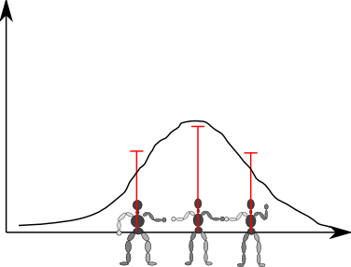
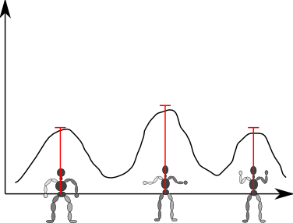
So we need to sequentially estimate (Details covered in Advanced topics in data modeling)
Kalman filtering
Particle filtering
Assume Gaussianity and linearity of observations and states.
Estimate mean state and covariance.
Particles: A state and a weight:

Slide 12
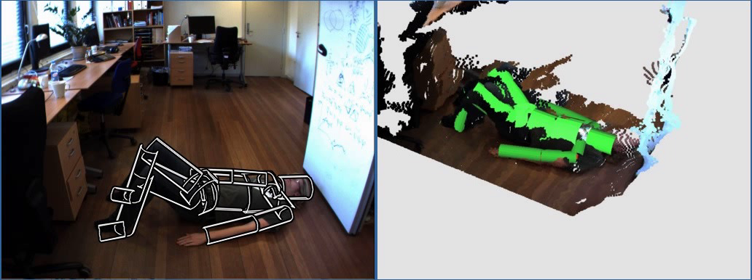
Voila! We now have a visual tracker
Notes:
Anvender I størrelsesordnen 100 partikler
<number>

Slide 13
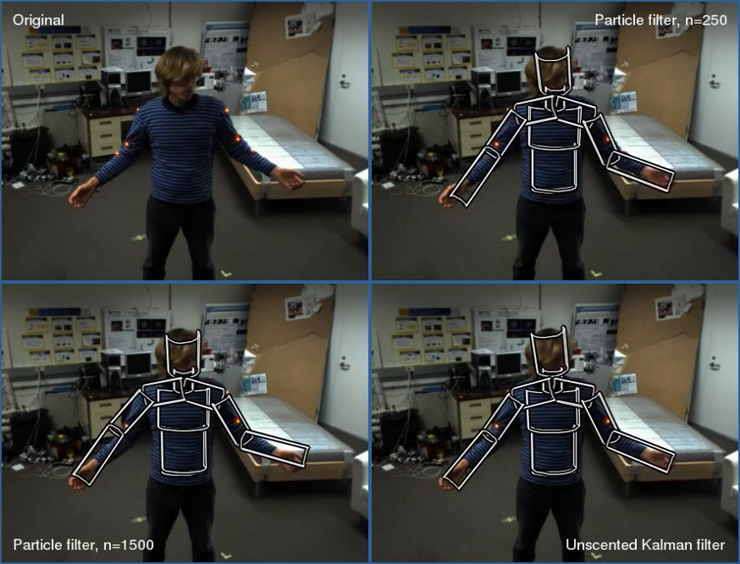
And here is another sequence showing different inference methods
Notes:
NOTICE how the amount of particles has a huge impact on the tracking quality.
<number>

Slide 14
Per frame part-based recognition of pose (A model-free approach used in MS Kinect SDK)
Shotton et al.: CVPR 2011
Notes:
This is the methods used by Microsoft in their X-Box 360 and MS Windows kinect tracker:
For each depth pixel predict which part it belongs to (pixel classification (random forest of decision trees) / part distribution estimation – color is the most likely part) Based on this part distribution predict joint 3D locations (for each part corresponding to a joint perform a local search for the mode of the part distribution using MeanShift)
This method requires a lot of training data (millions of examples of different body sizes and poses)
<number>

Slide 15
Summary
Visual tracking of 3D human motion:
Marker-based
Marker-less
Marker-less tracking:
Model-based (what we saw in detail)
Model-free
Model-based tracking requires:
Human body model
Relation between model and observations
Tracking is sequential filtering of the predicted pose (too avoid jitter in the estimated pose).

Slide 16
Literature
Reading material:
R. Poppe: Vision-based human motion analysis: An overview. Computer Vision and Image Understanding, 108 (1-2): 4-18, 2007.
Additional material:
J. Shotton et al: Real-Time Human Pose Recognition in Parts from Single Depth Images. Proceedings of CVPR, 1297-1304, 2011.
S. Hauberg and K. Steenstrup Pedersen: Predicting Articulated Human Motion from Spatial Processes. International Journal of Computer Vision, 94(3): 317-334, 2011.
R. Poppe: A survey on vision-based human action recognition. Image and Vision Computing, 28(6): 976-990, 2010.
Notes:
<number>

Slide 17
Remember to fill in the students course evaluation

Slide 19
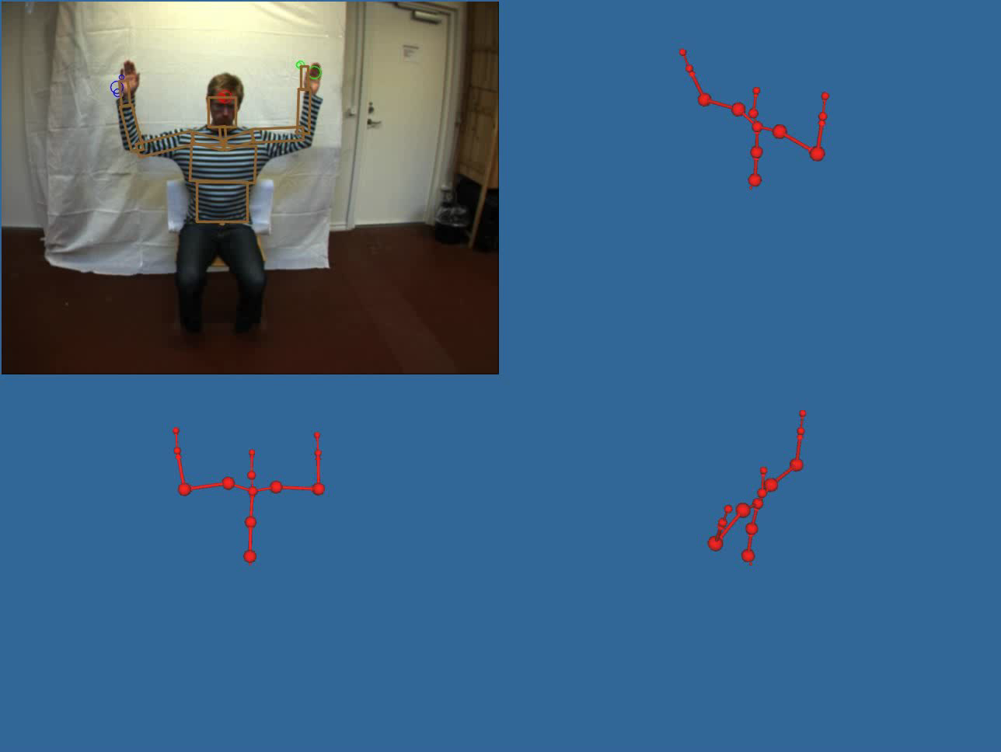
3D Marker-less motion capture (Upper body) (Using a single optical camera)
[Hauberg et al, 2009]
Notes:
We want to estimate joint positions or joint angle configuration from video without markers.
<number>

Slide 20
Why do we want to do tracking of human motion?
Human computer interaction: Non-invasive interface technology
Computer animation: Entertainment (movies and games), education, visualization
Notes:
<number>

Slide 21
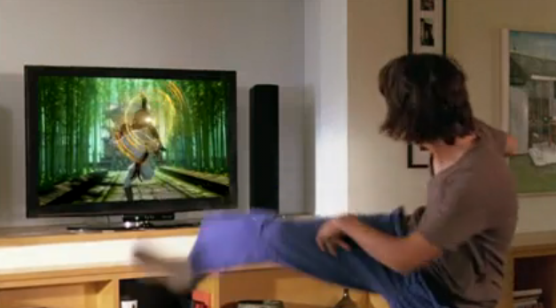
Computer games: Microsoft Kinect interaction technology
http://www.youtube.com/watch?v=g_txF7iETX0
Notes:
The MS kinect is an active stereo camera.
<number>

Slide 22
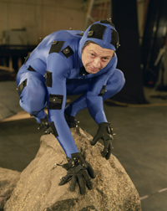
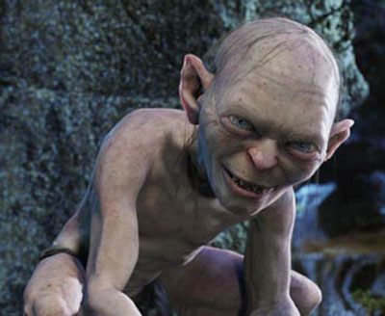
Computer animation: Transfer motion from actor to CG character

Slide 23
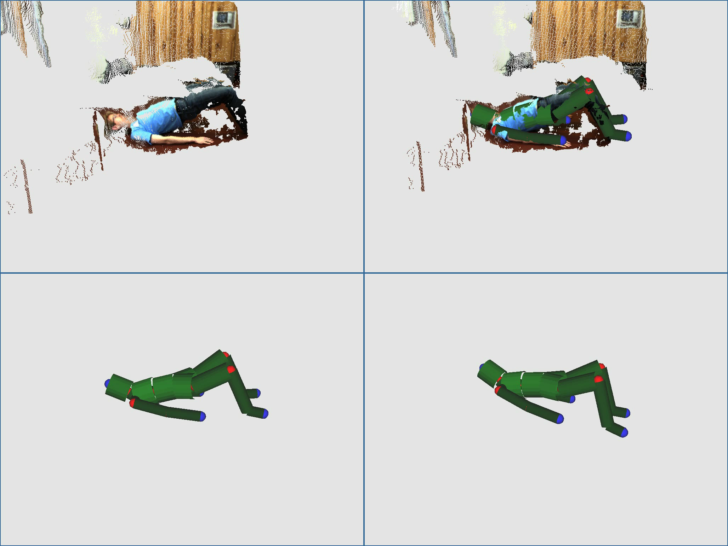
Interactive physiotherapy: Measurements

Slide 24
Modeling the skin surface
Common surface models:
Boxes
Cylinders
Quadrics
Polygonal mesh skin models

Slide 25
Human body model constraints
Natural physical constraints:
Body limitations, e.g. joint angle limits, limb dimensions (volume, length, etc.), …
Non-penetrability of limbs
Angular velocity and acceleration limits
Constraints can be modeled as either hard or soft constraints.
Notes:
Bent your elbow too much and it will break!
We are not able to move at the speed of light, so we might want to put some limits on angular velocity and acceleration.
<number>

Slide 26
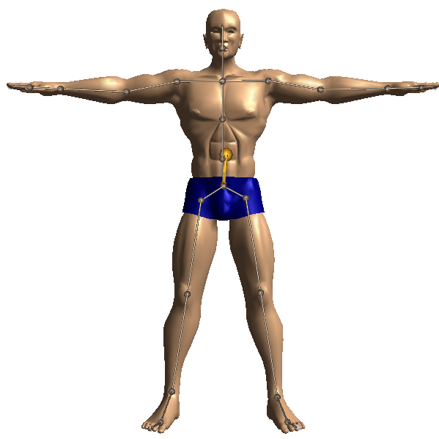
Visual human motion modeling and tracking (Tracking = seq. estimation of model from observations)
Model: Stick figure representation of human body (rigid sticks connected by joints, no mass).
Model parameters a.k.a. the state: Vector of joint angles
Observations: Video sequence of motion
Notes:
E.g. D=50
<number>

Slide 27
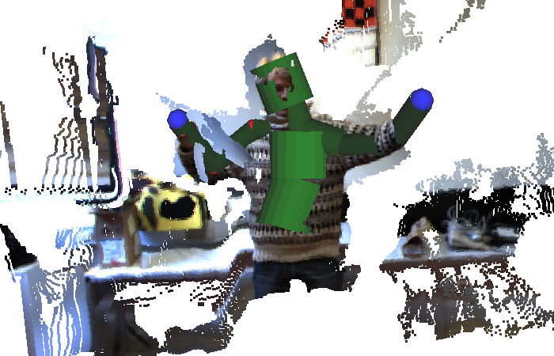
Observations in practice
compares the image (here a stereo depth map) and state
Notes:
<number>

